Slide 1
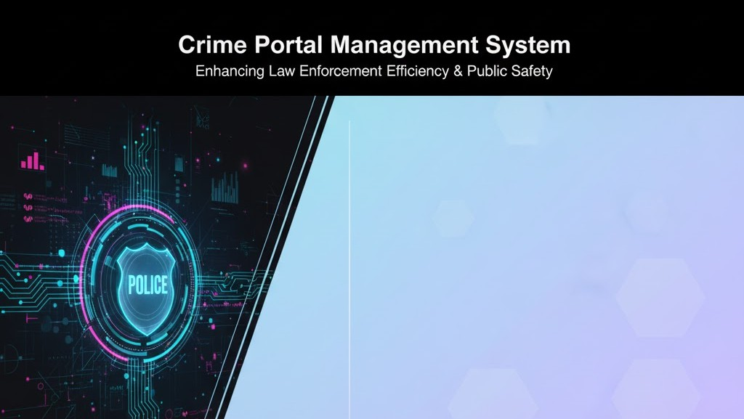
JAVA PROGRAMING LAB
PRESENTED By:- Ayush Gangwar
GUIDED By: MR. CHETAN DHAKAD
TEAM MEMBERS:
JATIN SHARMA ADITYA RAJ PRTHAM KUMAR SANJEEV MAURYA PALLAVI KUMARI NEHA GANGWAR

Slide 2
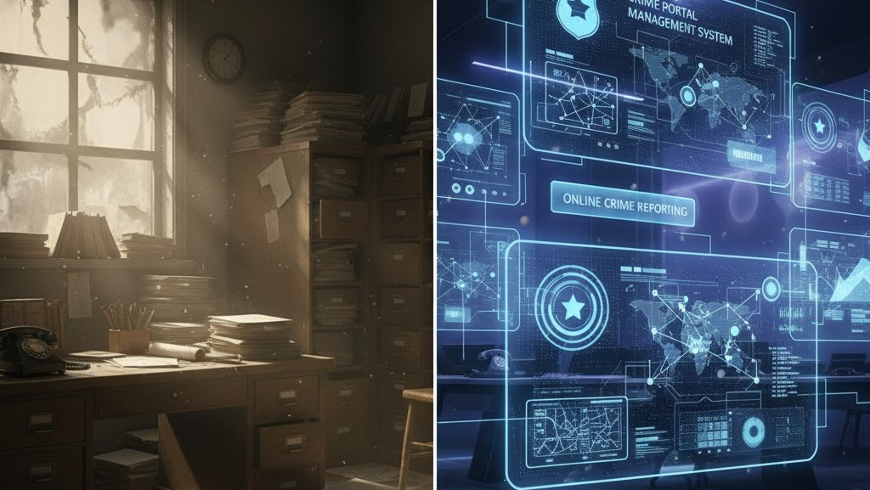
Introduction
A web-based platform that allows users to report crimes online.
Makes it easy for citizens to submit complaints from anywhere.
Provides police with a digital system to track and manage cases.
Enhances transparency between the public and law enforcement.
Improves accuracy and reduces the overall response time.

Slide 3
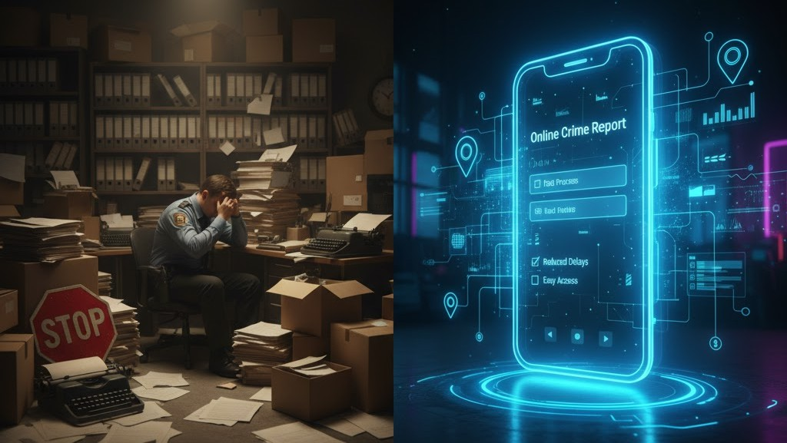

PROBLEM STATEMENT
Traditional crime reporting is slow and inconvenient.
Manual records cause delays. Citizens hesitate to visit police stations.
A digital solution is required for faster and better crime management

Slide 4
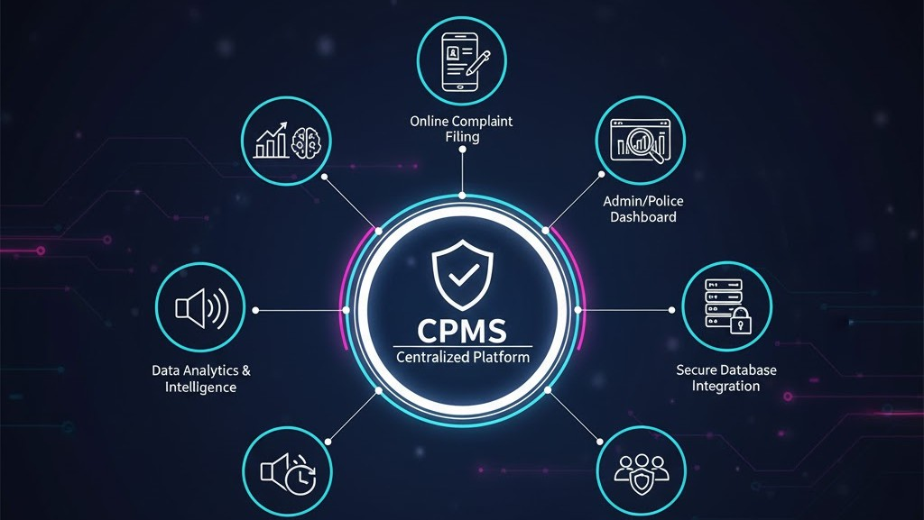
Proposed Solution
Real Time Update & Tracking
Public Access Module

Slide 5
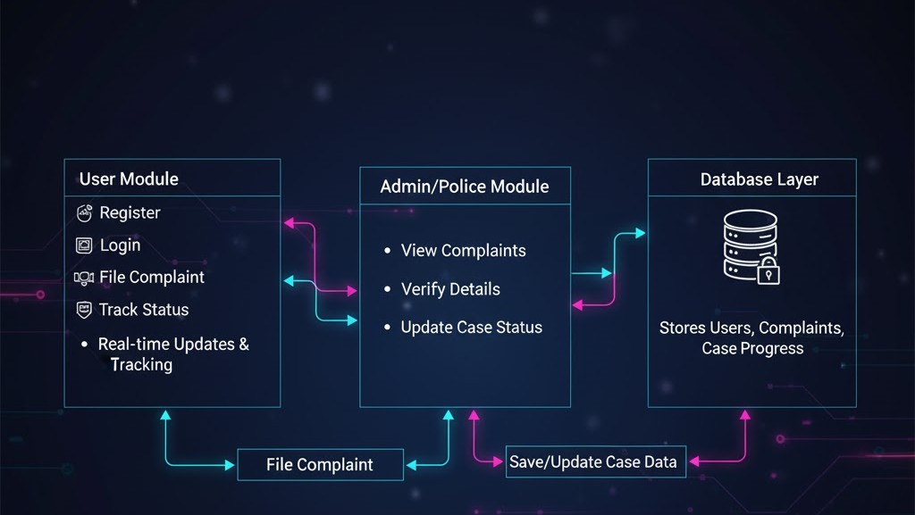
SYSTEM ARCHITECTURE / WORK FLOW

Slide 6
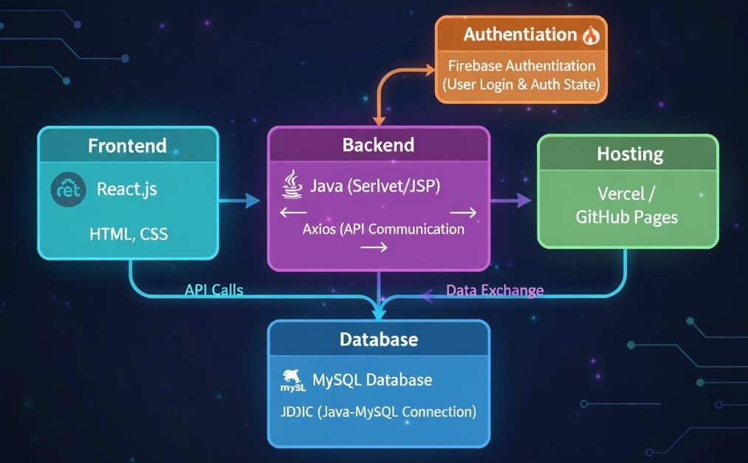
TECHNOLOGY STACK

Slide 7


KEY FEATURES
User authentication (Login/Register) File a complaint online
Case tracking system Admin dashboard for police Secure database storage Responsive interface Automated status updates

Slide 8

CONCLUSION
The Crime Reporting and Management System successfully digitalizes the reporting process.
It provides a fast, secure, and efficient way for both the public and the police to interact.
The project enhances transparency and helps in better crime monitoring and control

